Slide 1
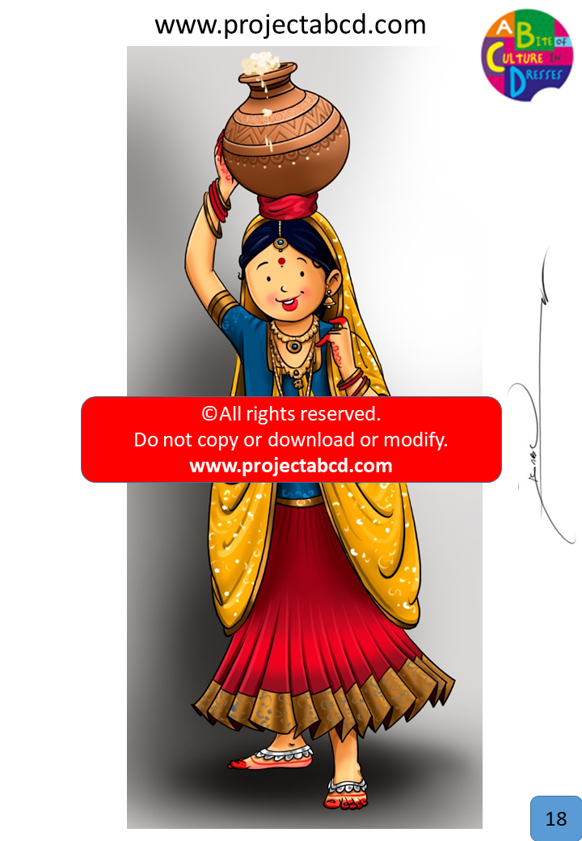

Slide 2
Milk Maid
Description:
Milkmaids are women who milk cows. They also generally prepare products made out of the milk, such as churning butter or making buttermilk. Milkmaids work all over the world.
Fun Fact:
Indian milkmaids typically carry urns on their heads because they can hold 3-4 urns at once. Some women even balance urns on their heads completely.

Slide 3
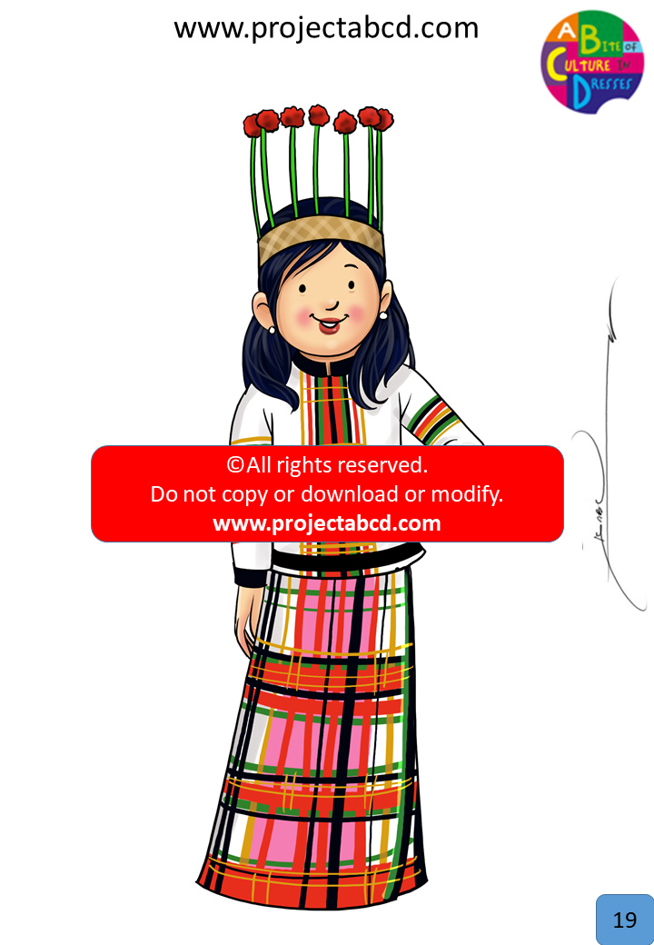

Slide 4
Puanchei
Description:
The Puanchei is the traditional dress of Mizoram. It is two pieces (full sleeves top and skirt) sown together with intricate designs. The skirt is not flowy like the lehenga/ghagra, but rather straight and stiff made from cotton. The base color is generally white with black, green, and red horizontal and vertical stripes across. The headpiece is like a woven crown with 'flowers' coming up that have a green stem and red flower.
Fun Fact:
The Puanchei is worn on nearly all occasions in Mizoram, from religious occasions to weddings!

Slide 5
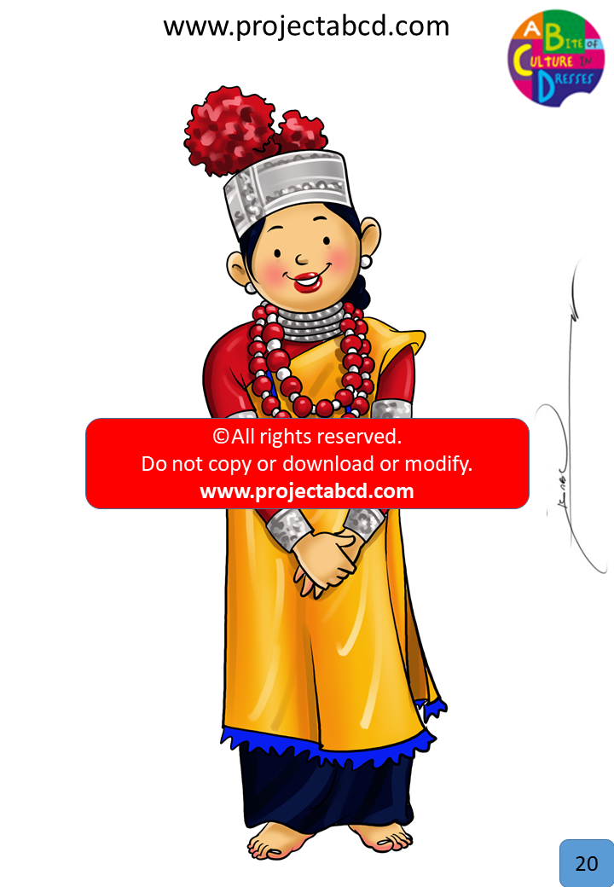

Slide 6
Khasi Dress*
Description:
Women who belong to the Khasi tribe of Meghalaya wear a Jainsen and blouse. The Jainsen wrap covers the body from the waist to ankles. On top, a cotton shawl called tap-moh khlieh is worn, and it looks similar to an apron. Ornaments of pure gold and silver are usually worn along with the beautiful outfit. Senior women of the tribe also Jainkup, which is made from woolen cloth. On special occasions, a fancier version of this dress is worn.
Fun Fact:
Meghalaya is the only state in India that follows the matrilineal system, where inheritance is traced through women.

Slide 7
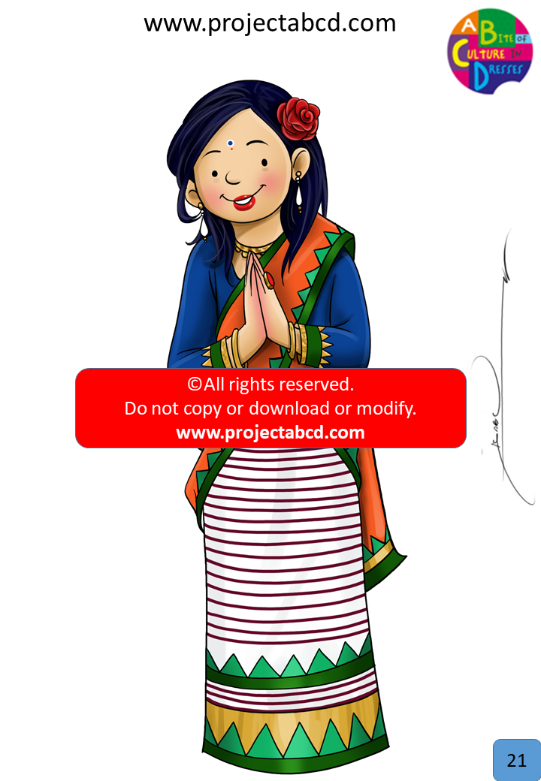

Slide 8
Angami Dress
Description:
The Angami Dress style is from Nagaland. There is a plain cloth skirt (white color). It has has thick black marginal bands of a variety of breadth. They also wear Mechala, that wrap around skirt with an accompanying shawl.
Fun Fact:
Different tribes in Nagaland have their own festivals, meaning one major festival lined up for all the months in the year!

Slide 9
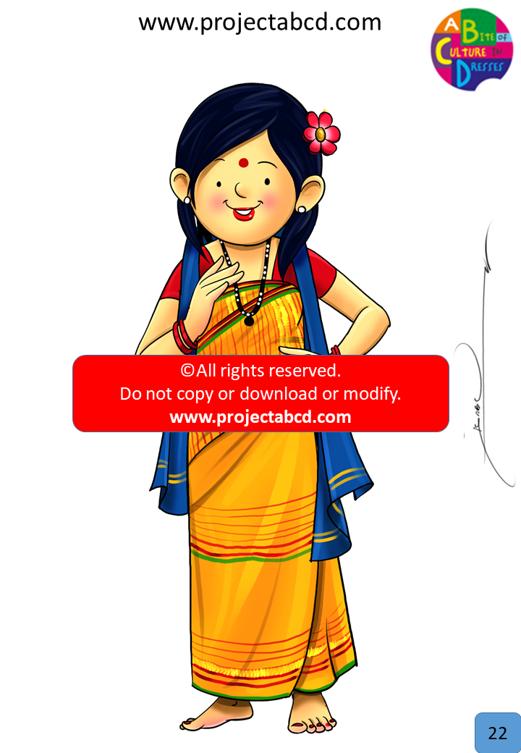

Slide 10
North East TBD
Description:
updated
Fun Fact:

Slide 11
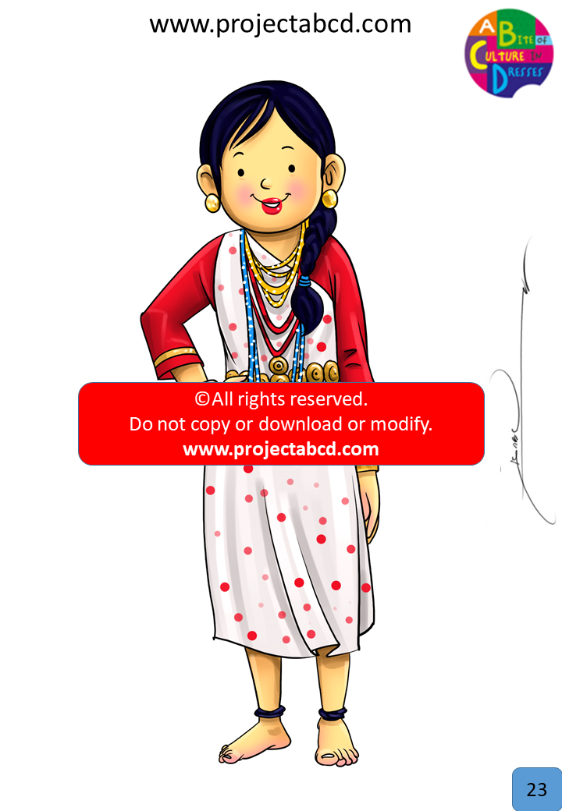

Slide 12
North East TBD
Description:
Slide23
Fun Fact:

Slide 13
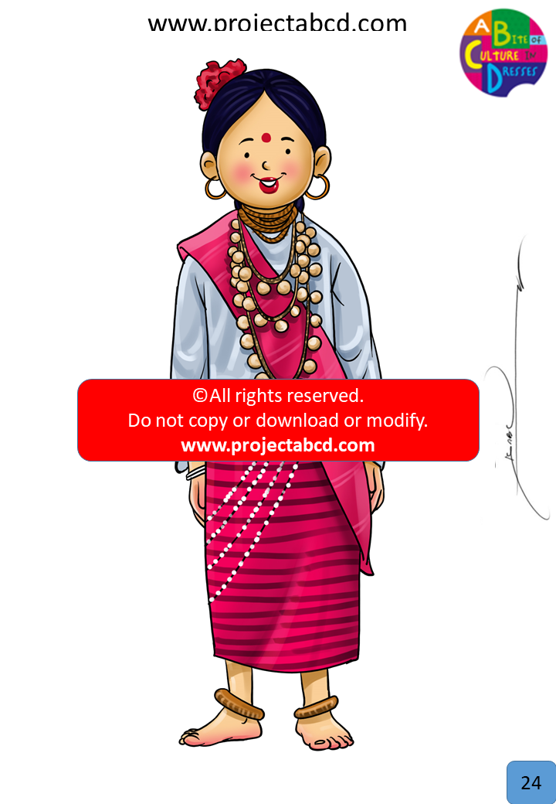

Slide 14
North East TBD
Description:
Slide24
Fun Fact:

Slide 15
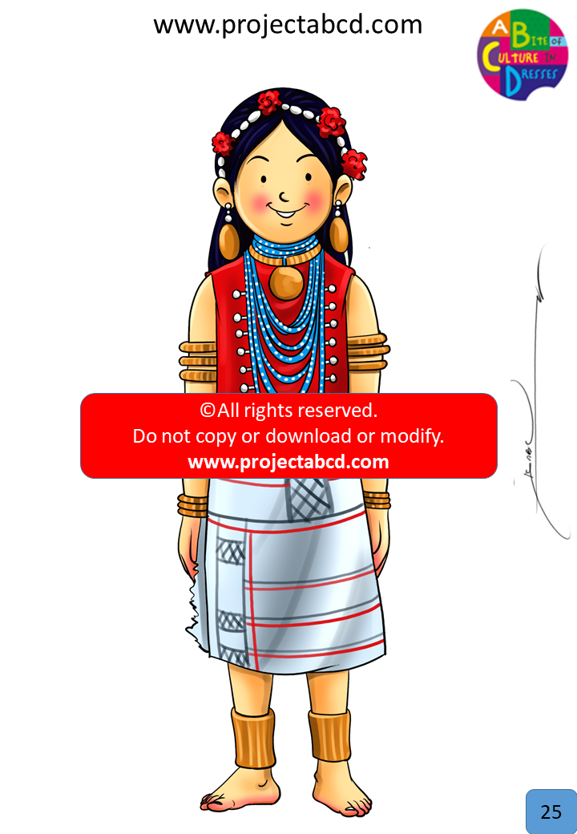

Slide 16
North East TBD
Description:
Slide25
Fun Fact:

Slide 17
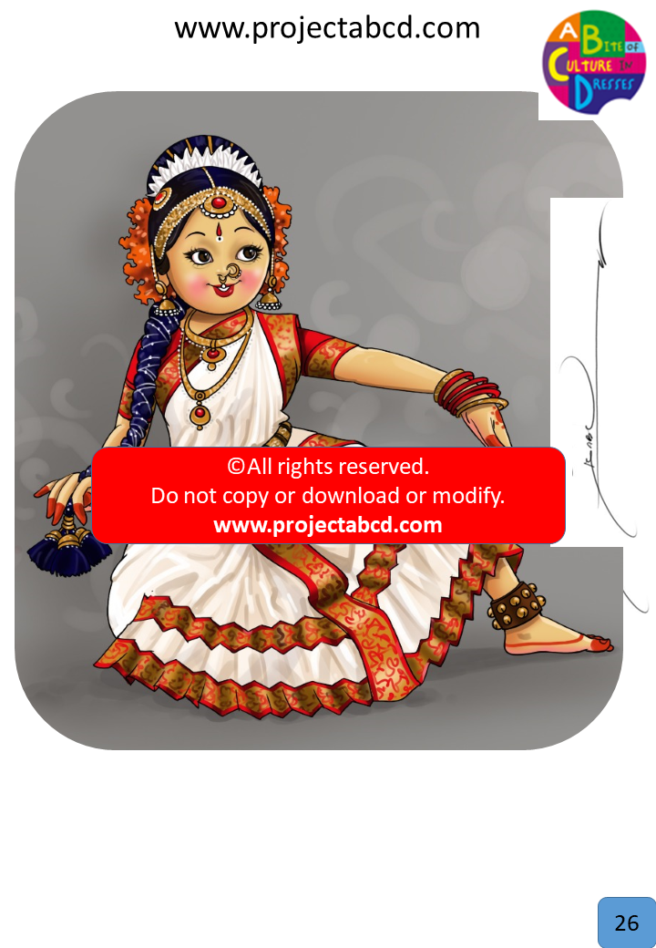

Slide 18
Kuchipudi
Description:
Kuchipudi is a classical dance form that originated in Andhra Pradesh. It is known for its quick footwork, expressive eye movements, and dramatic characterization. Kuchipudi costumes are similar to those of Bharatanatyam costumes, it is made from a silk saree and has a pallu on top and pleated fan underneath.
Fun Fact:
A unique feature of Kuchipudi is the Tarangam, in which the performer dances on the edges of a brass plate.

Slide 19
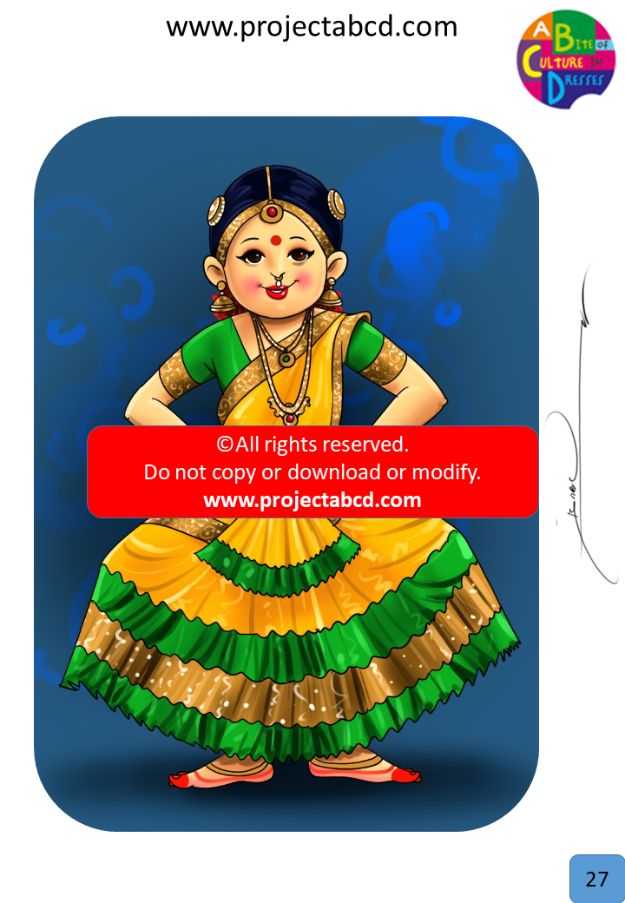

Slide 20
Bharatha Natyam
Description:
Bharatanatyam is a major classical dance form that originated in Tamil Nadu. The dancers wear sarees with embroidered designs stitched to form beautiful pleats that fan out when the dancer forms certain poses. There are two different common styles of Bharatanatyam dresses, a skirt style or a pyjama style.
Fun Fact:
Bharatanatyam is believed to be a dance dedicated to fire as the movements of the body in this art form resemble those of fire.

Slide 21
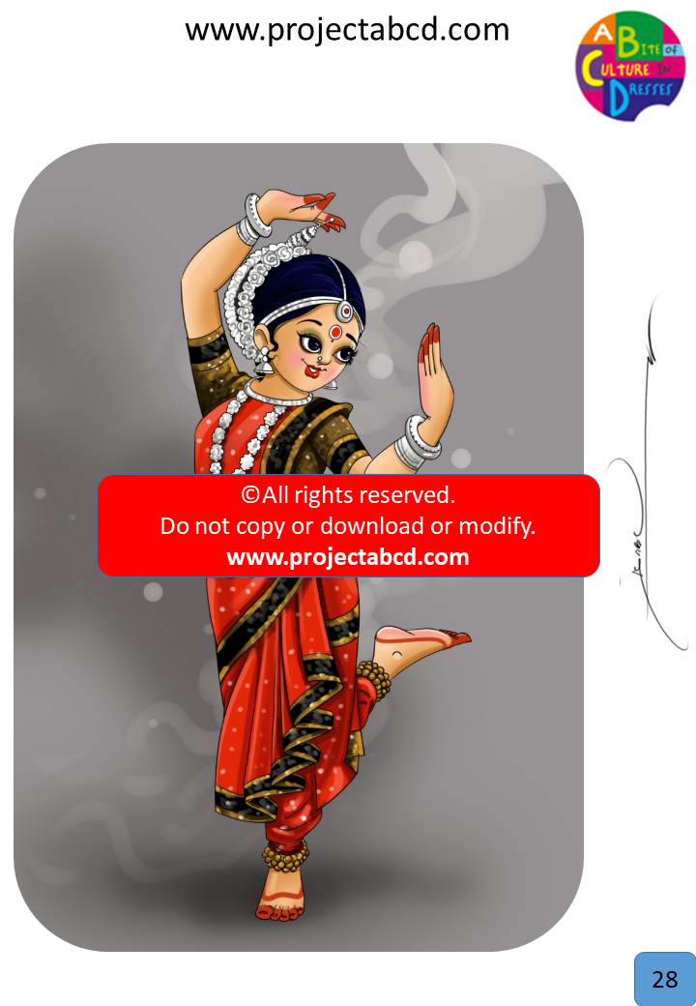

Slide 22
Odissi
Description:
Odissi is a classical dance form that originated in the coastal state Orissa. The dress is made from a silk saree with traditional designs embroidered on it. The front part of the saree is worn with a pleated fan or a separate cloth to ensure flexibility of movements by the dancer.
Fun Fact:
Odissi is believed to be the oldest existing Indian dance form based on archaeological evidence.

Slide 23
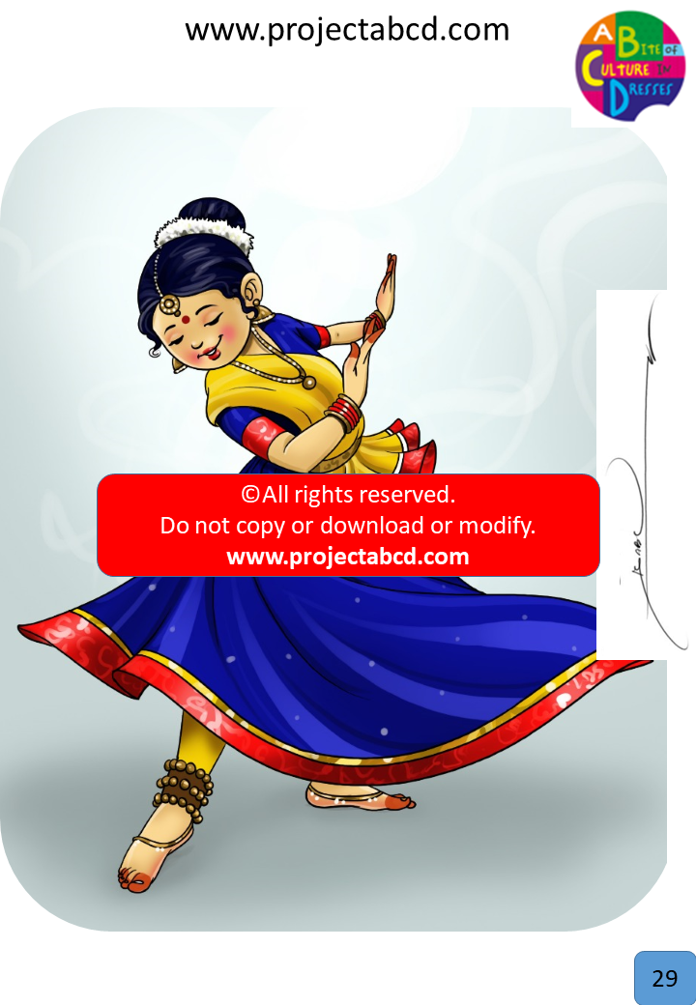

Slide 24
Kathak Dancer
Description:
Kathak is a traditional dance in India. Kathak dancers wear a special outfit but it is very similar to a ghagra choli or a anarkali. Depending on the type of dance the outfit may change.
Fun Fact:
Kathak dates back to the 4th Century B.C!

Slide 25
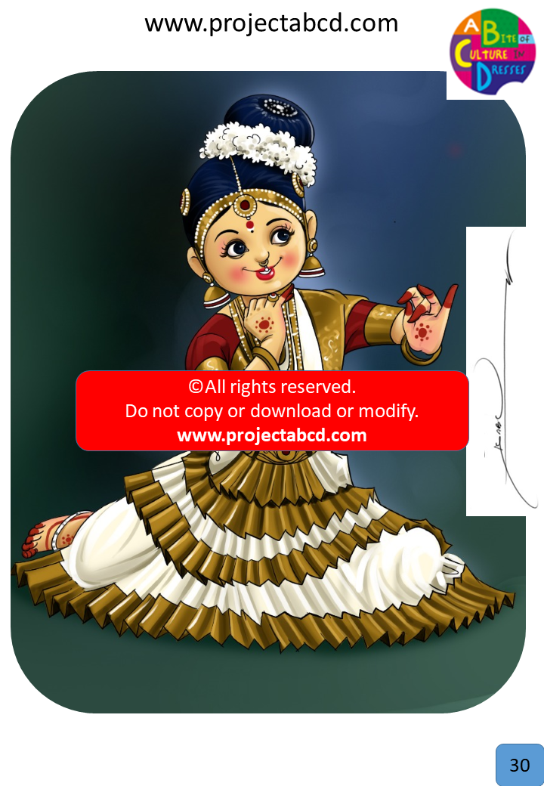

Slide 26
Mohiniyattam
Description:
Mohiniyattam is the traditional dance form of Kerala performed exclusively by women. The costume is made out of the highly sought after Kerala Kasavu saree, a creamy white saree with rich golden borders. As many other Indian classical dance costumes, it also has a pleated fan that goes around the waist.
Fun Fact:
The attire for this dance form is very specific, only gold jewelry, jasmine flowers, and Kerala Kasavu sarees are used.

